Slide 1
Identifying novel functional linear motifs using host-viral protein interactions and the principle of convergent evolution
Vitalii Kleshchevnikov
Evangelia Petsalaki’s group (Whole Cell Signalling)

Slide 2
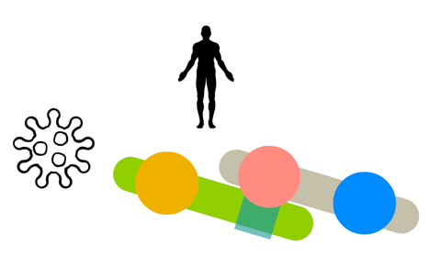
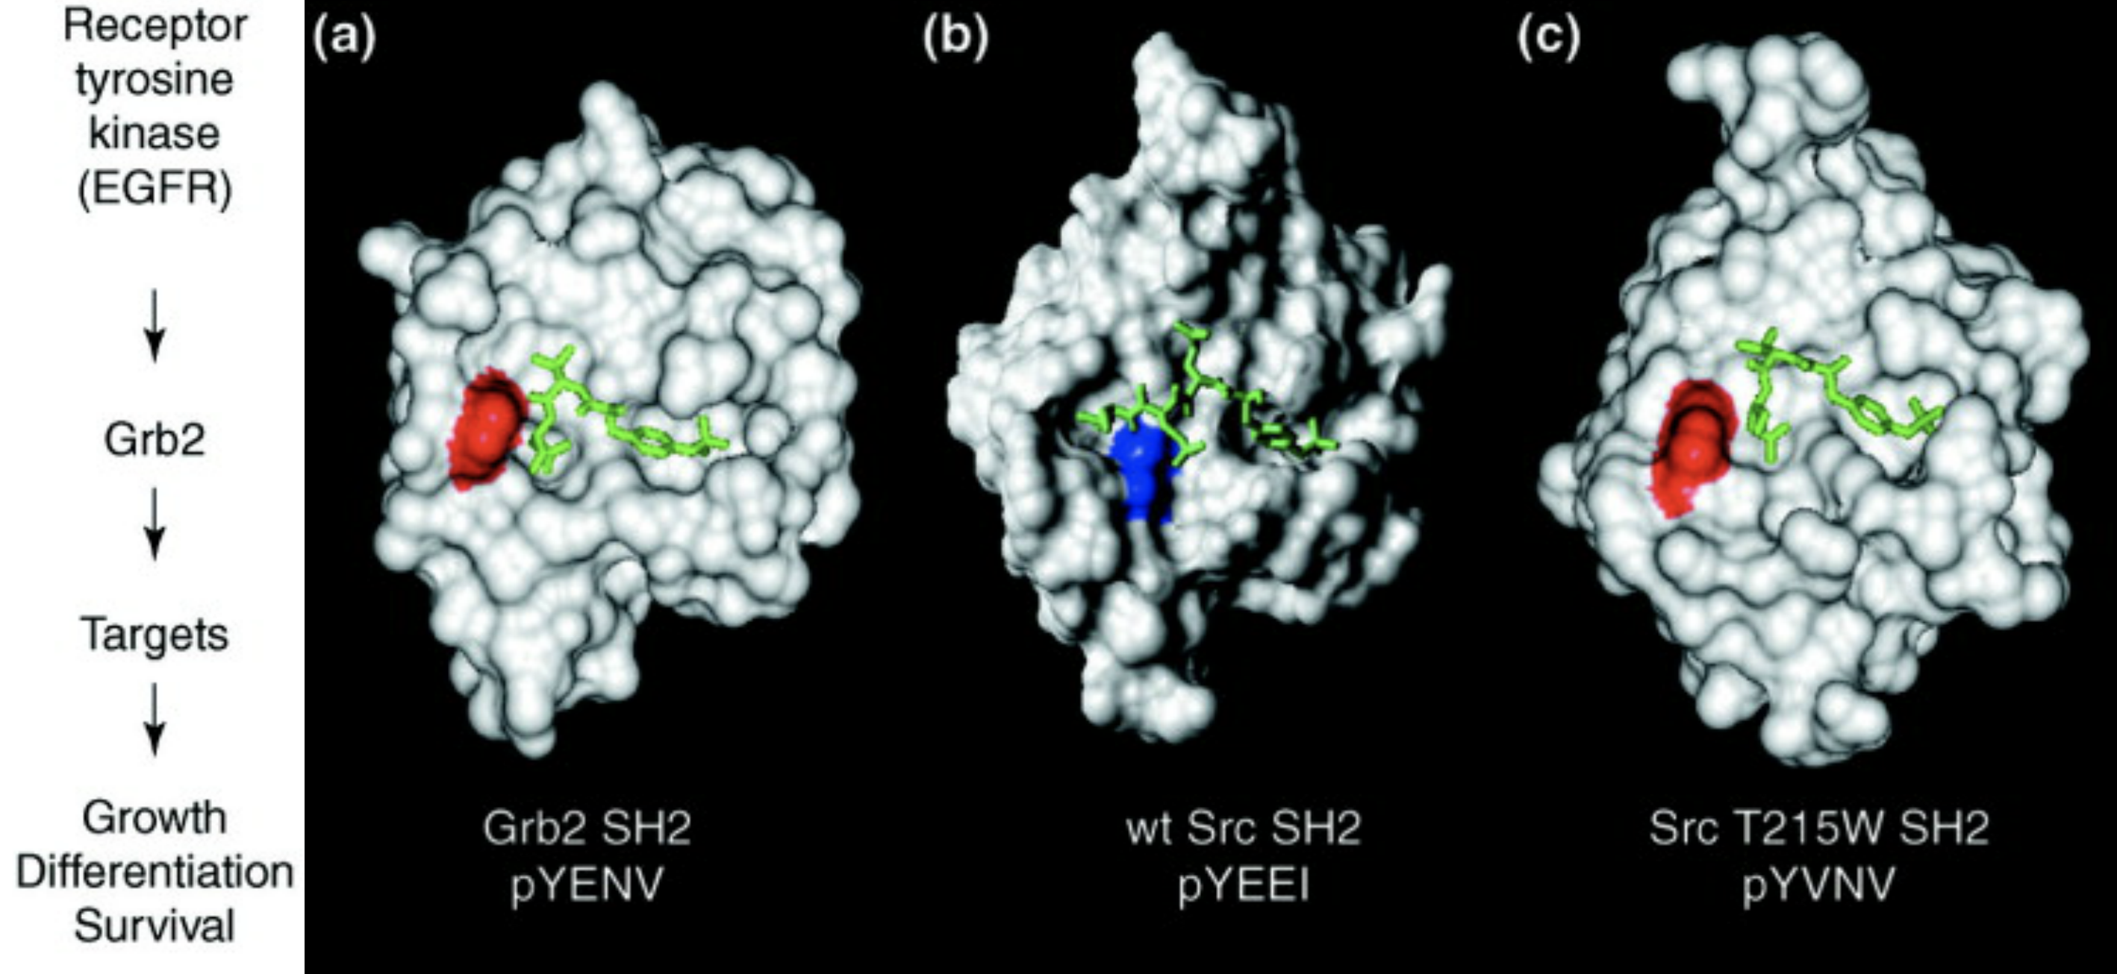
Background
Globular
domains
Linear
motif
quick and transient interactions
PTM-inducible switches
Pawson et al., 2001, PMID: 11719057
quick to evolve
can mediate rewiring of signaling networks

Slide 3
Background
Globular
domains
Hard to discover: the same sequence motif can be functional or not - depending on the part of protein where it is located
Usually located in disordered regions (also loops on the globular)
Linear
motif

Slide 4
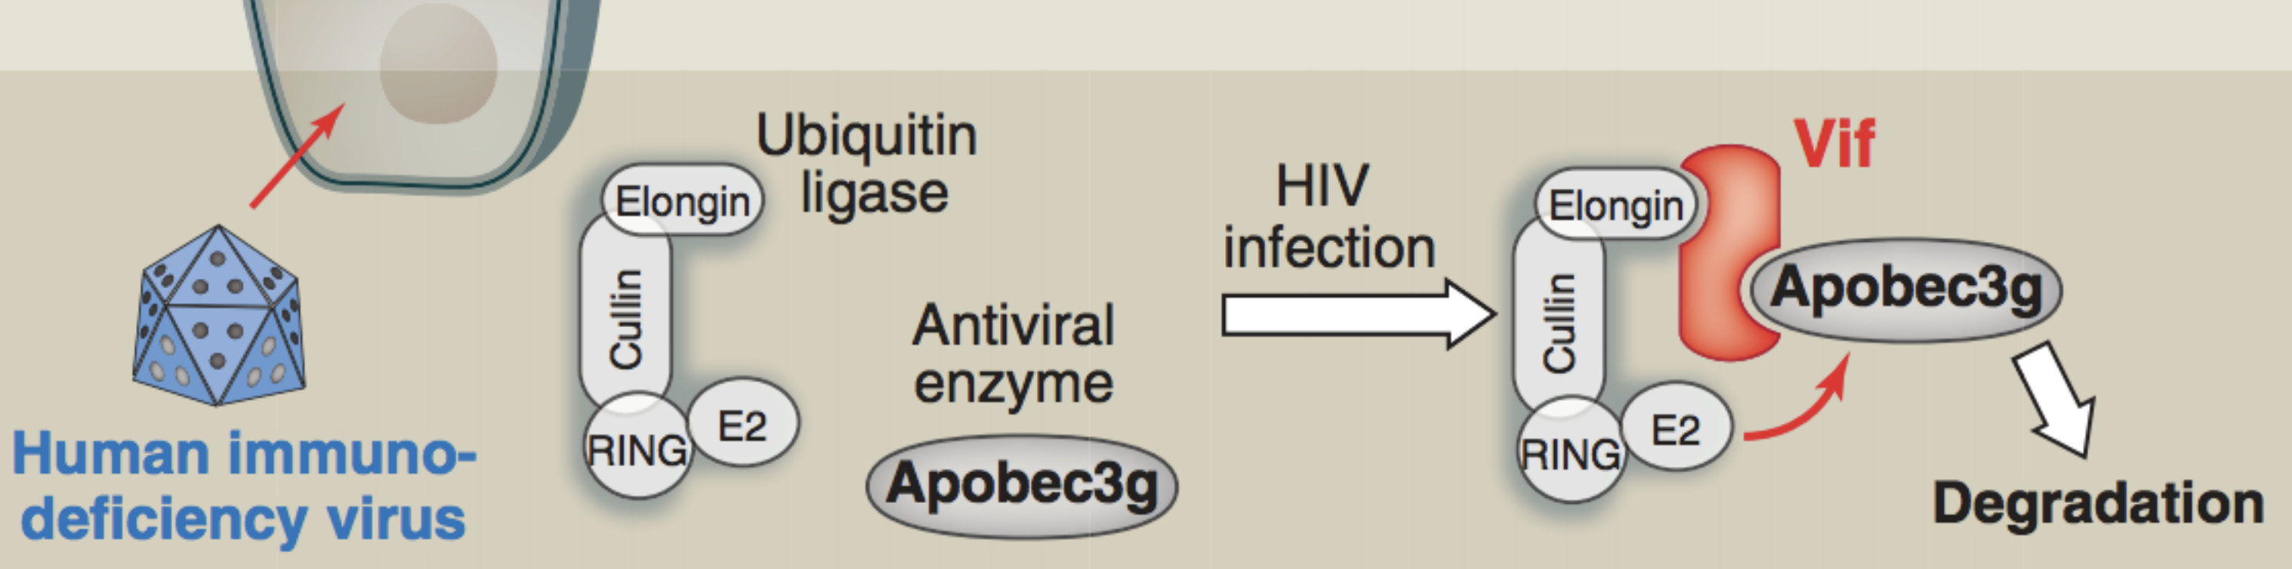
Background
Globular
domains
Viruses convergently evolve motifs
Linear
motif
Good et al., 2011, PMID:21551057

Slide 5
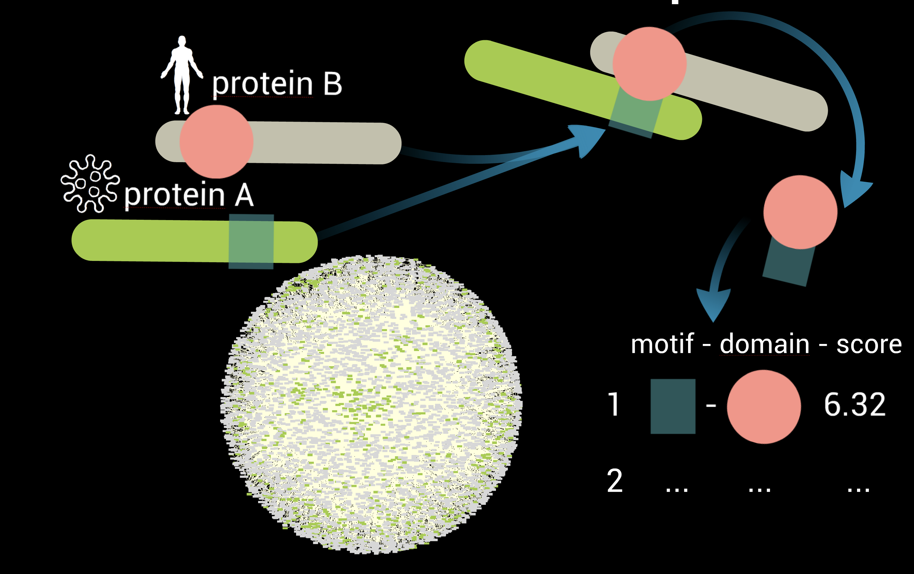
Our approach
Globular
domains
Linear
motif
Increase the sensitivity by using human-viral interaction data

Slide 6
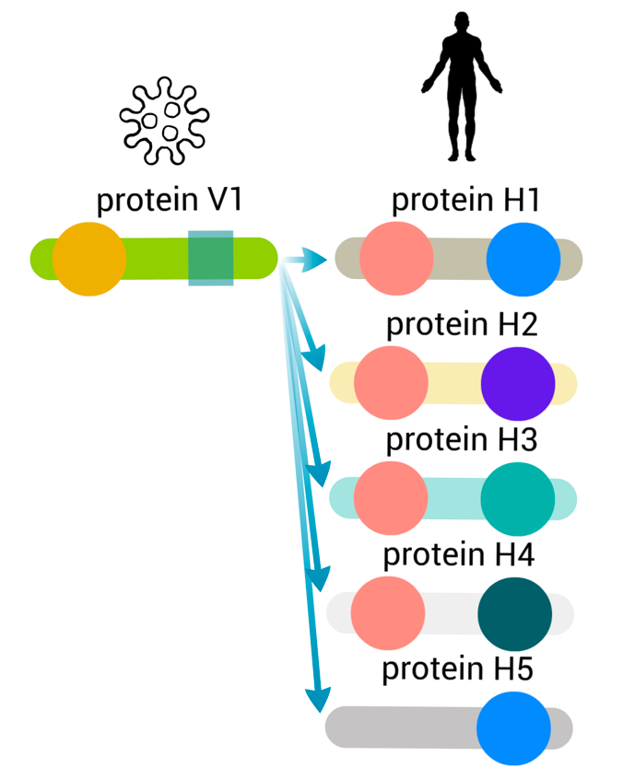


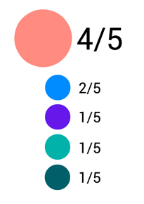

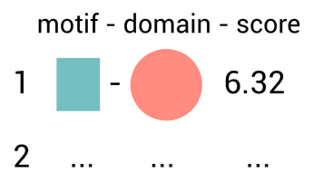

The Pipeline
Globular
domains
1
We obtain protein
interaction data from
Linear
motif
We estimate which
domains are enriched in the interaction subnetwork
3
2
We use to predict
known domains (sequence signature match)
4
use QSLIMFinder to discover linear motifs de-novo
Benchmark based on known instances
and regions necessary to interact
and combine domain-motif pairs
5

Slide 7
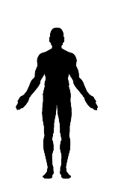

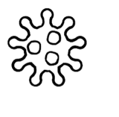
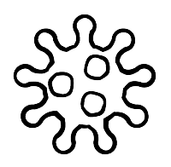
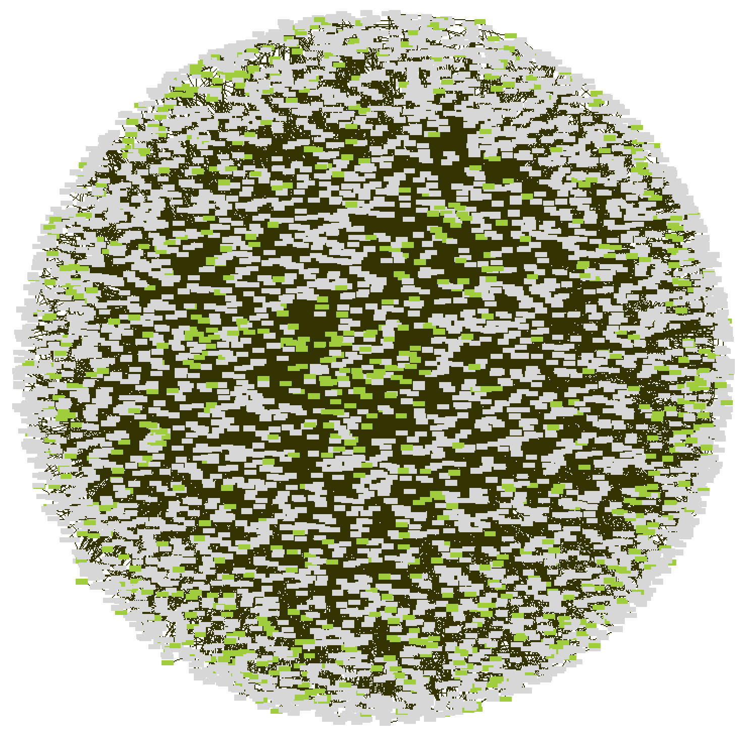
Interaction dataset
1
Full IntAct
4538 proteins
19399 proteins
14505 interacting pairs
887 proteins
155702 interacting pairs

Slide 8
1
Interaction dataset
Full IntAct

Slide 9
Interaction dataset
1
Matthias Mann data - AP-MS, HeLa
Hein, 2015
Marc Vidal data - Y2H,
Rolland, 2014 + unpublished
4952 proteins
8639 proteins
15601 interacting pairs
44764 interacting pairs

Slide 10
1
Interaction dataset
Marc Vidal data - Y2H,
Rolland, 2014 + unpublished
Matthias Mann data - AP-MS, HeLa
Hein, 2015

Slide 11
Predicting known domains
2
Notes:
,

Slide 12
Protein kinases and Zinc-finger proteins also identify domains enriched in ELM domains
ROC 2
ROC 1

Slide 13
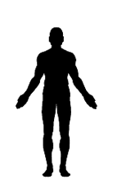
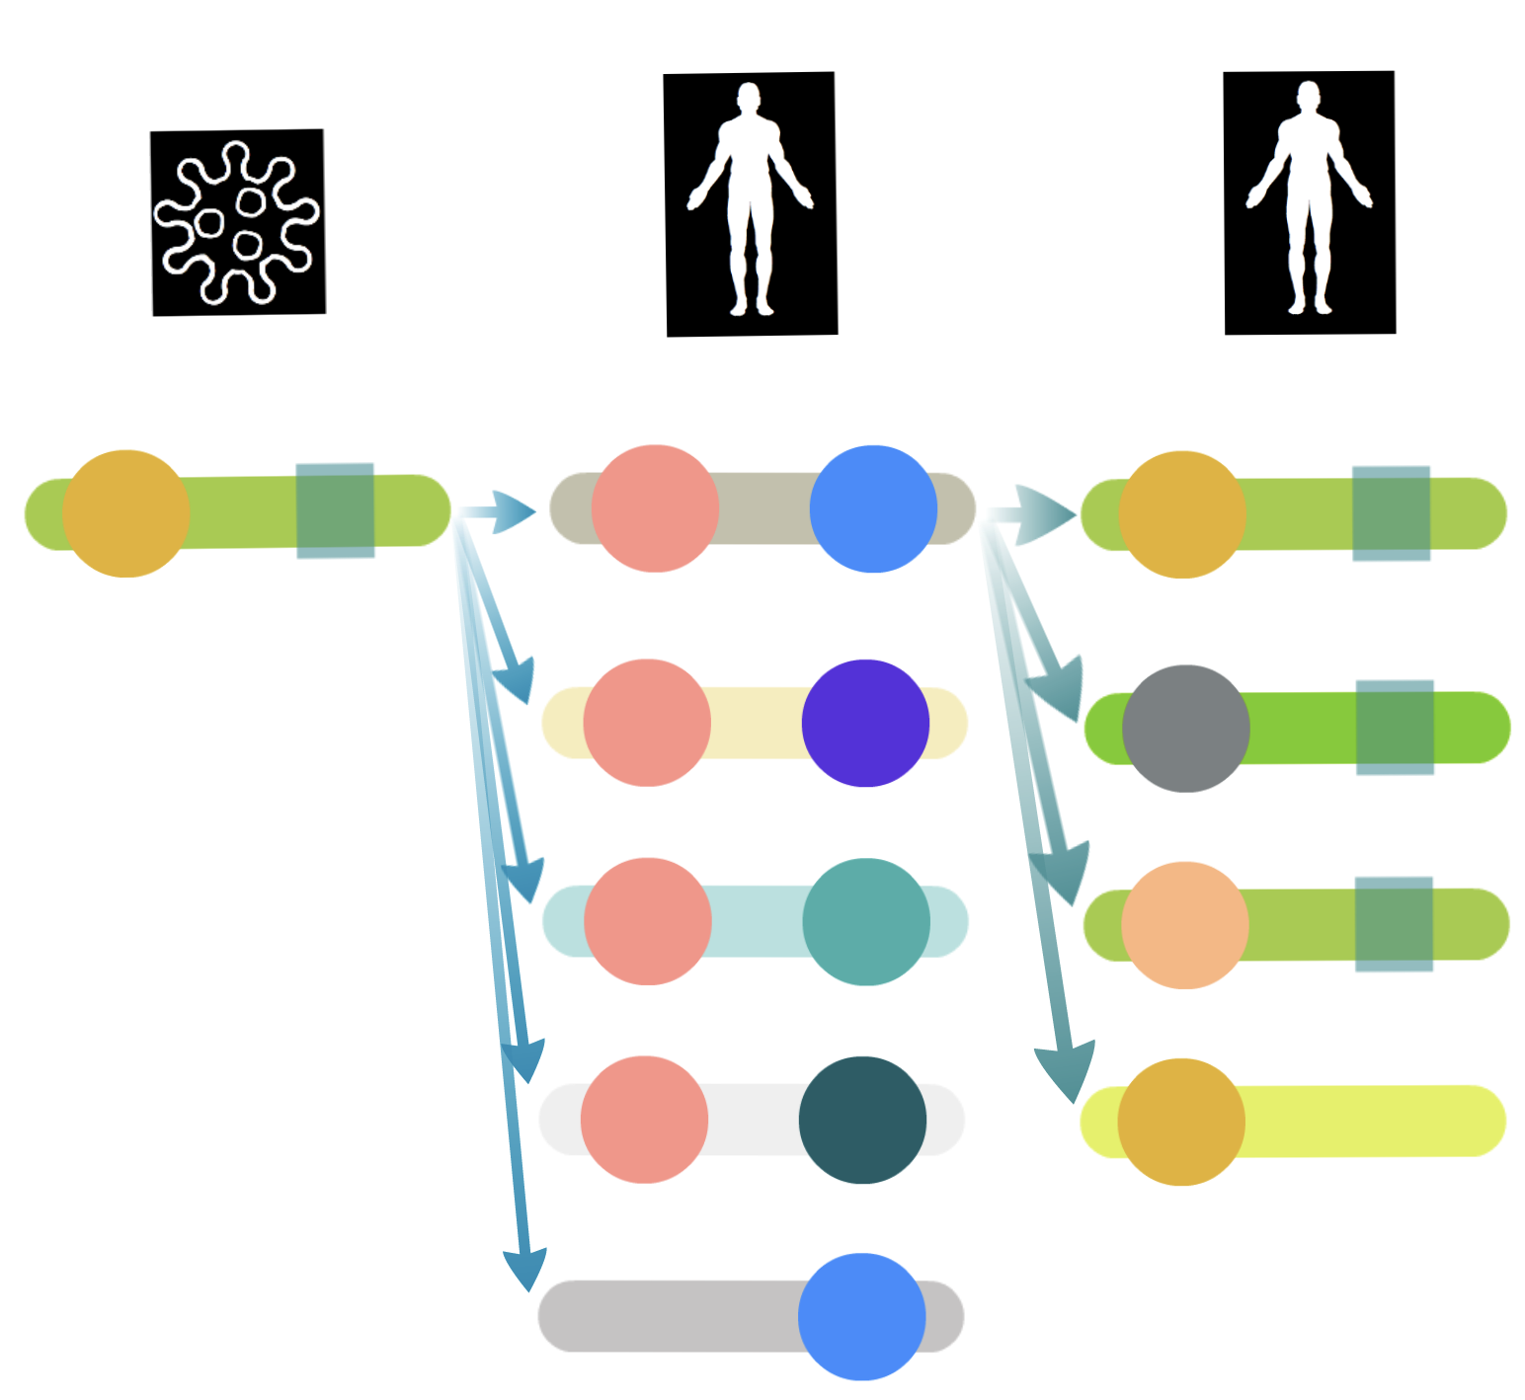
Motif search setup
4
QSLIMFinder: Palopoli & Edwards, 2015
1 viral human-network (non-query set)
3 human-human networks (non-query set):
- Full IntAct data: 11859 sequence sets
- Only Vidal’s data (Y2H): 10299 sets
- Only Mann’s data (AP-MS): 10152 sets
Query
Protein-centered
Non-Query
Only in disordered regions (IUPRED, 0.2)
Similar proteins grouped in clusters
Sequences for motif search
= Query + Non-Query proteins
Searching only for motifs present in query proteins leads to:
Higher sensitivity (reduced search space)
Higher specificity towards direct interactions
Notes:
Intrinsically unstructured/disordered proteins have no single well-defined tertiary structure in their native, functional state. Our server recognizes such regions from the amino acid sequence based on the estimated pairwise energy content. The underlying assumption is that globular proteins are composed of amino acids which have the potential to form a large number of favorable interactions, whereas intrinsically unstructured proteins (IUPs) adopt no stable structure because their amino acid composition does not allow sufficient favorable interactions to form.
http://rest.slimsuite.unsw.edu.au/docs&page=module:qslimfinder
BLAST e-value threshold for determining relationships [1e=4] and grouping similar proteins in clusters

Slide 14
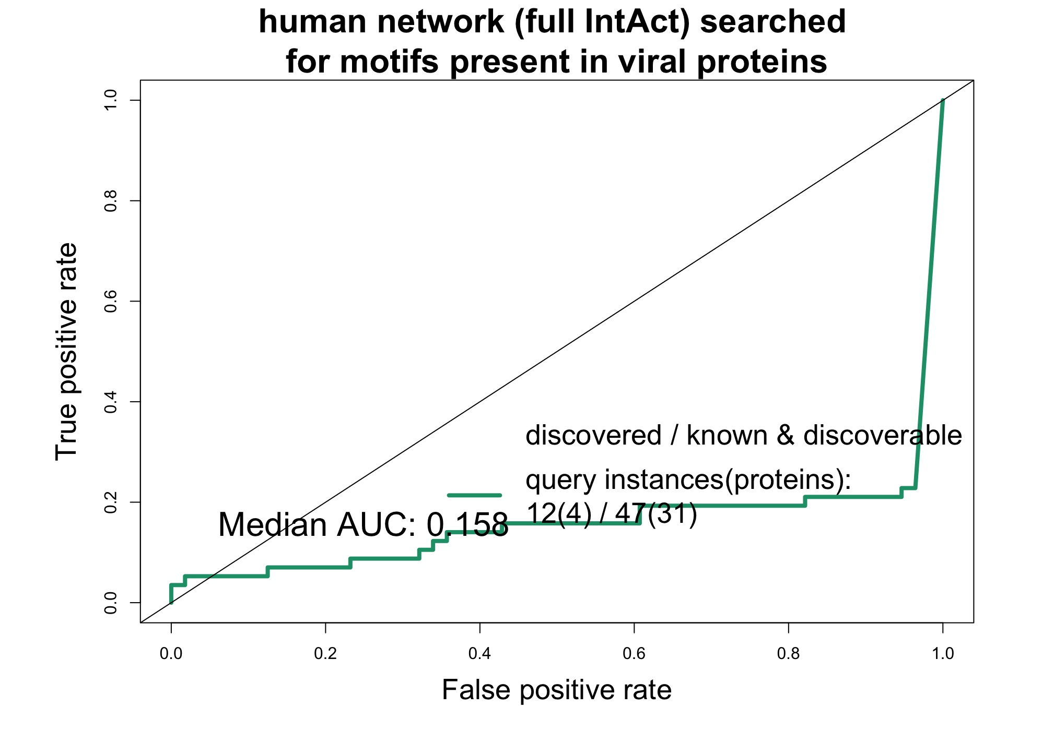
Evaluating performance
5
Query
Non-query
Positive set: known linear motif instances from ELM DB
Ligand-binding sites
Post-translational modification sites
Negative set: predicted AND NOT known motifs in the same proteins

Slide 15
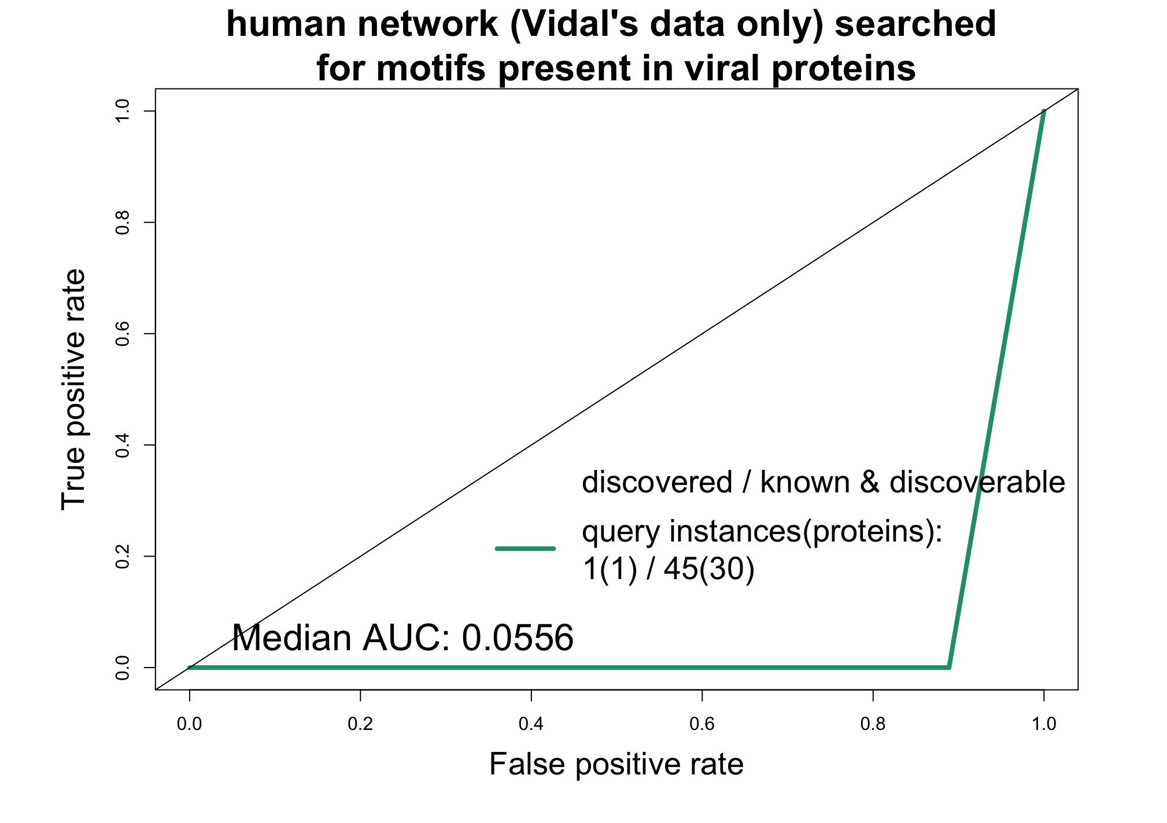
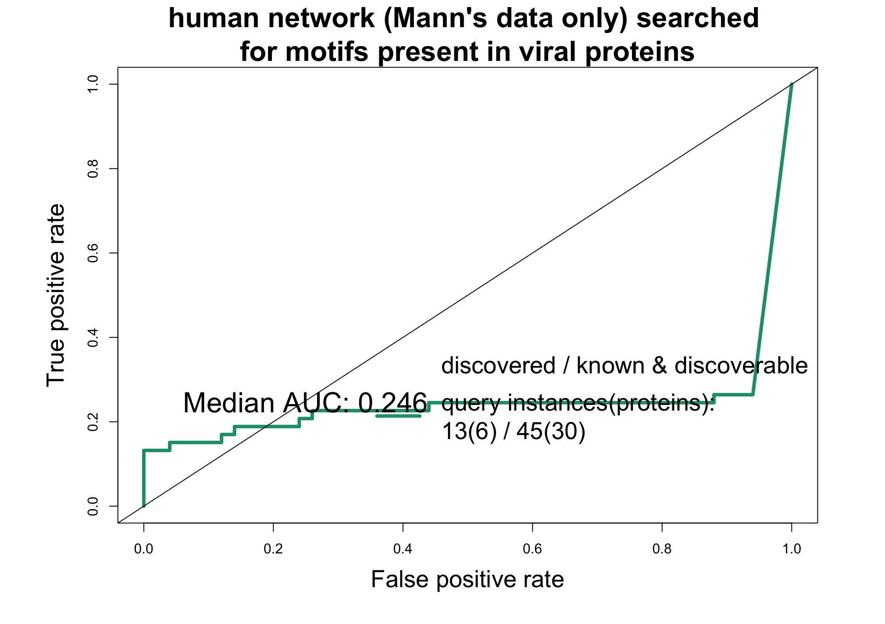
5
Evaluating performance: interaction datasets
Unbiased two-hybrid
Unbiased AP-MS

Slide 16
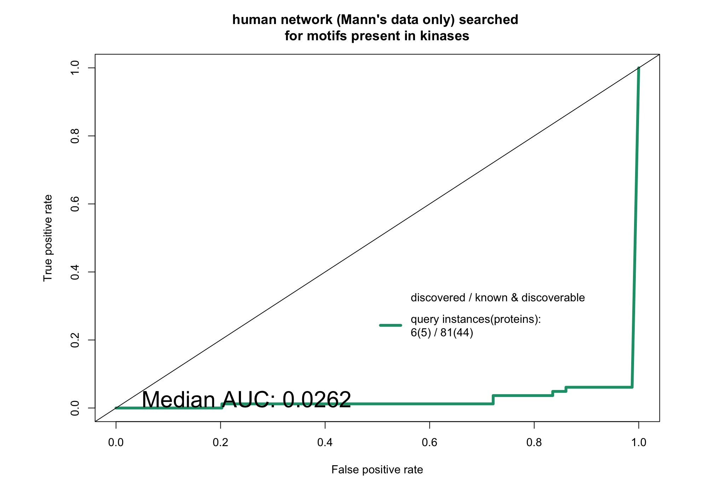
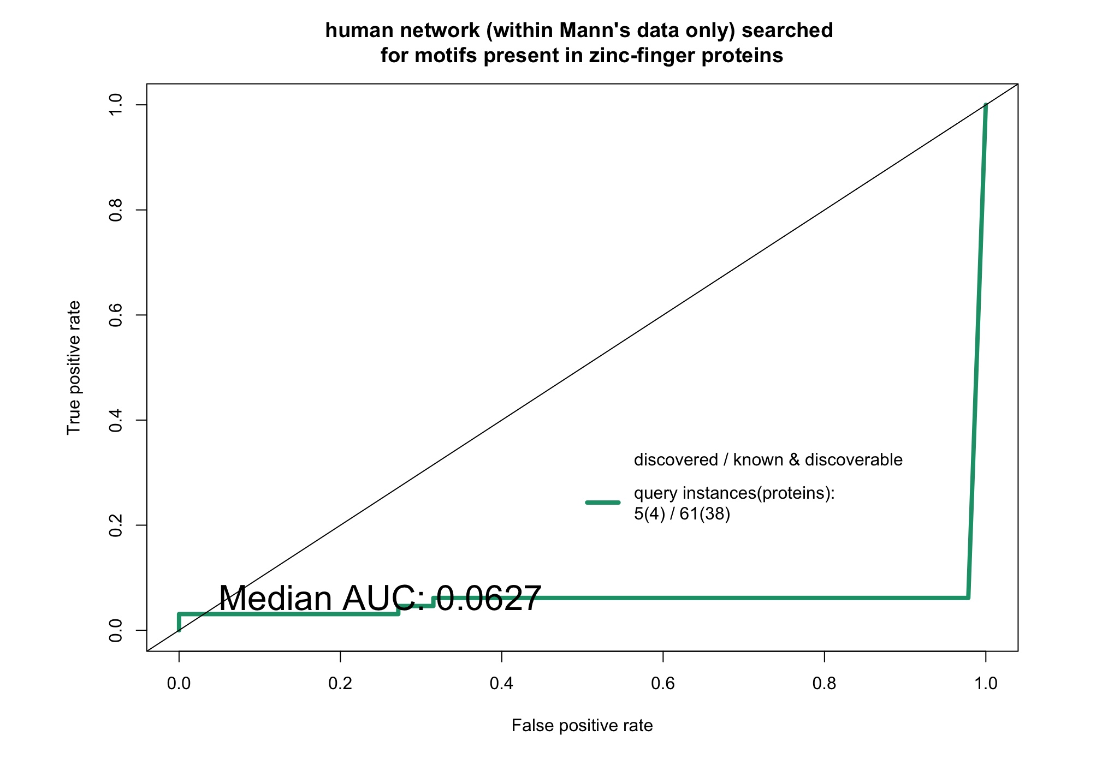
Do viral proteins help? YES, kinases and Zn-finger proteins yield nothing
5
All data
kinases
Zn-finger proteins

Slide 17
Do viral proteins help? Known SLIM-binding domain proteins and random proteins
5
random proteins
Known SLIM-binding domain proteins

Slide 18
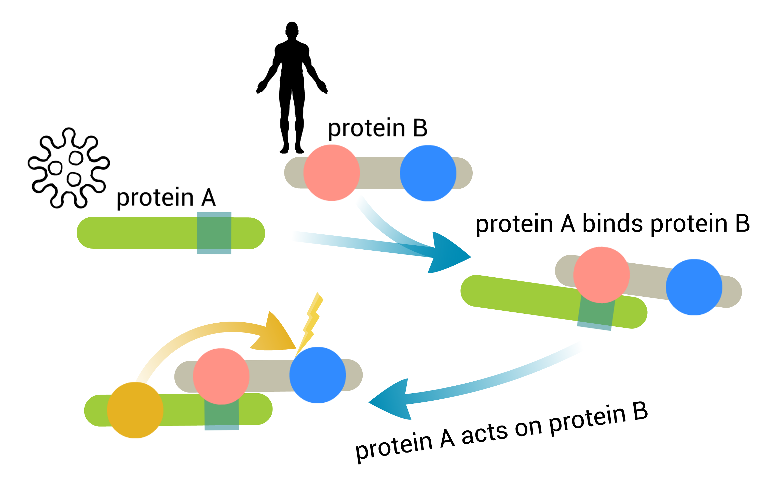
Identifying domains likely to mediate interaction
3
HYPOTHESIS
Domains are enriched in the interaction subnetwork
Proxy for domains likely to mediate interactions
Score motifs higher if the domain is present
NOTE: Viral protein might be binding human proteins with related functions: could not distinguish such preference from true binding domain

Slide 19
Predicting known domains
2
Viral-interacting
4538 proteins
2858 domains
1961 in Pfam
Domains are distinct functional, structural or sequence units that may exist in a variety of biological contexts. A match to an InterPro entry of this type indicates the presence of a domain.
CATH-Gene3D, CDD, HAMAP, PANTHER, Pfam, PIRSF, PRINTS, ProDom, PROSITE, SFLD, SMART, SUPERFAMILY, TIGRFAMs
Notes:
,

Slide 20
Estimating which domains are enriched in the subnetwork
3
2 methods:
1. Fisher’s exact test (domain frequency in the interaction subnetwork / in the full network)
2. Empirical p-value for seeing the frequency (such as 4/5) independently of the specific domain
Notes:
How many human proteins should contain a domain of interest out of all proteins that interact with a specific viral protein so that we can say with % confidence (p-value) that a viral protein binds that domain.

Slide 21
Estimating which domains are enriched
3
Empirical p-value for the frequency
Positive set: known ligand-binding domains from ELM DB
Negative set: all other domains
Ranked by: significance
Notes:
How many human proteins should contain a domain of interest out of all proteins that interact with a specific viral protein so that we can say with % confidence (p-value) that a viral protein binds that domain.
The description of the method:
How many human proteins should contain a domain of interest out of all proteins that interact with a specific viral protein so that we can say with % confidence that a viral protein binds that domain.
Reflects the association between the total number of human proteins the viral protein interacts with and the fraction of these proteins containing a specific domain (Fisher's exact test doesn't account for this).
The rationale is that the number of human proteins that should contain a domain of interest for us to say with % confidence that a viral protein binds that domain changes as a viral protein gains more interacting partners. In a viral protein has only one human partner we cannot possibly identify which of the domains in that single protein are mediating interactions. Our ability to identify this domain grows a the degree of viral protein grows.

Slide 22
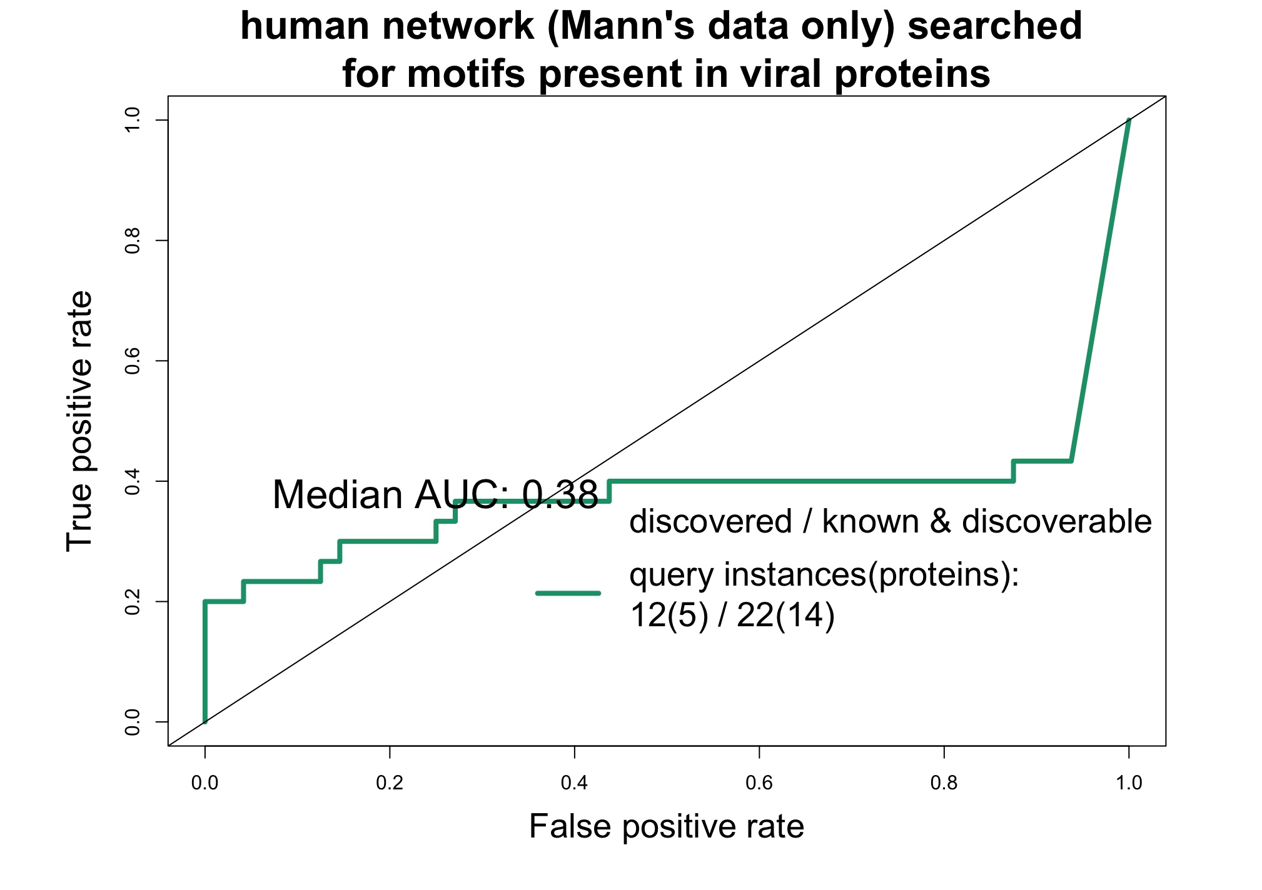
Evaluating performance
5
Before filtering domains
After filtering domains

Slide 23
Linear motif search results
Out of 5987 sets of proteins 682 sets returned 548 motif patterns and 3326 motif instances in 654 proteins. (the probability of finding each motif by chance < 0.3)
After the FDR correction and filtering at p < 0.05, 105 sets has returned 91 motif pattern and 810 motif instances in 197 proteins.
Most of these have some degree of similarity with known motifs

Slide 24
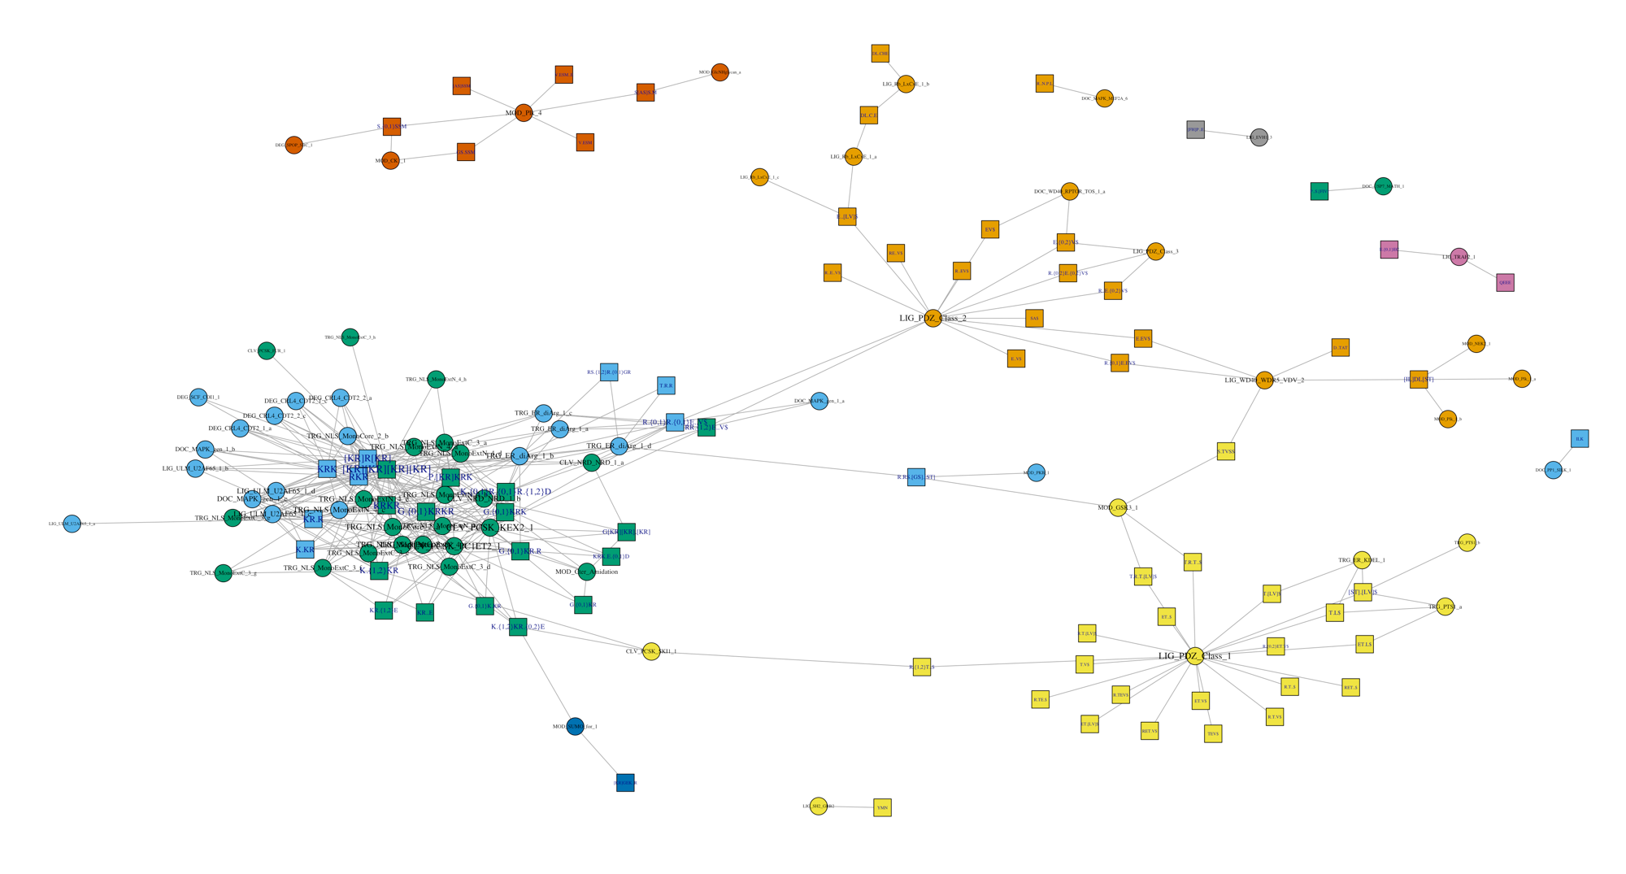
5
Most motif patterns are similar to known motifs
Information content > 0.5
Comparimotif V3
Edwards, Davey & Shields, 2008
Notes:
Squares are motifs

Slide 25
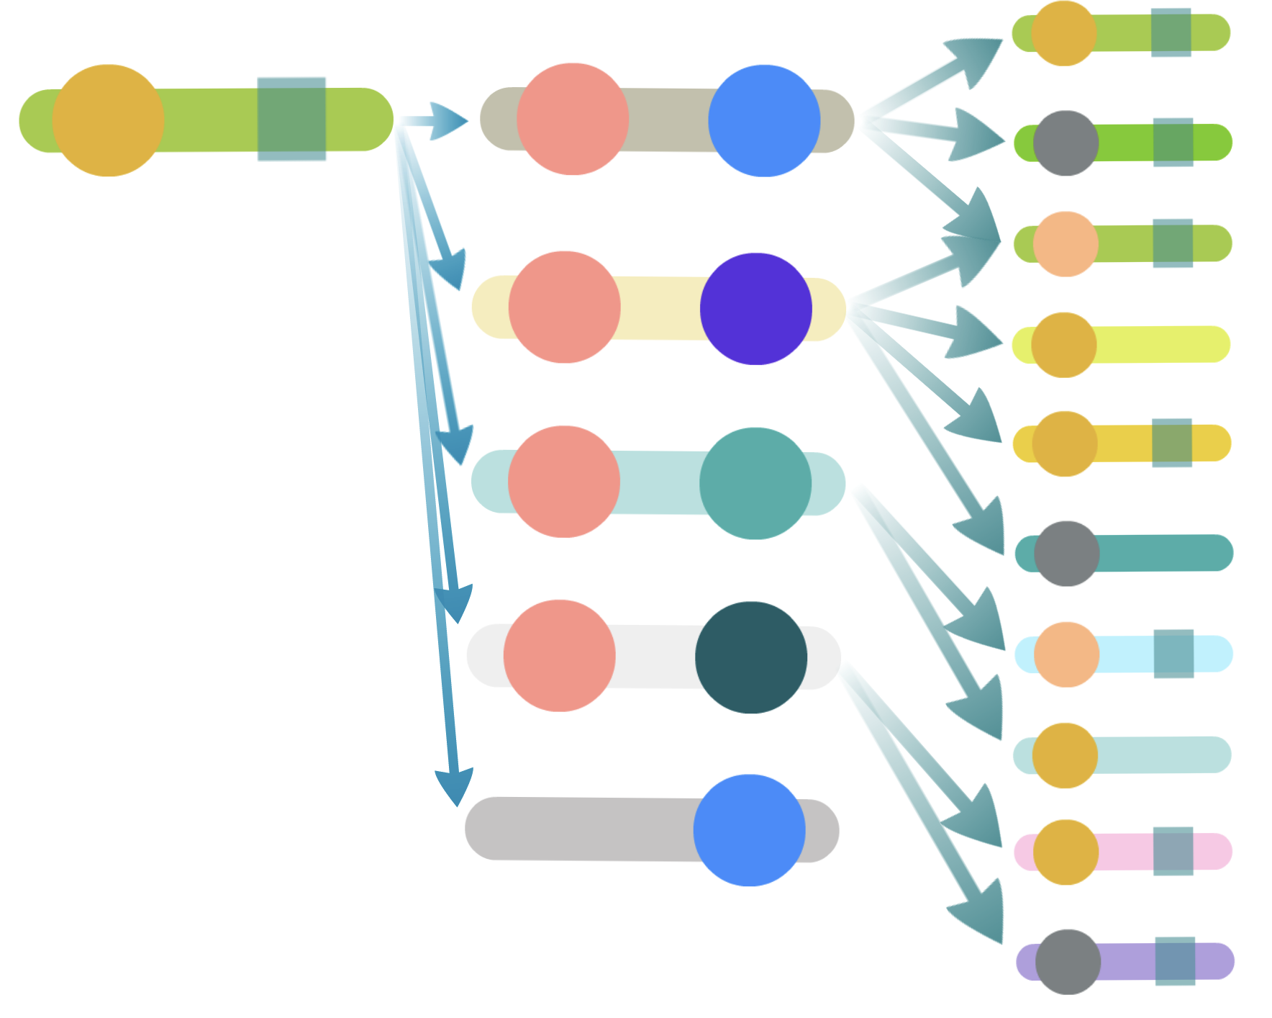
Domain-centered datasets
Non-query
Query
Query
Non-query
Finds motif even if interactions were randomised
Query QSLIMFinder identifies more motifs than SLIMFinder
(including randomised network)

Slide 26
Evaluating performance
5
Query
Non-query
Positive set: known linear motif instances from ELM DB
Ligand-binding sites
Post-translational modification sites
Negative set: predicted AND NOT known motifs in the same proteins

Slide 27
Compare query QSLIMFinder to simple SLIMFinder
Non-query
Query
Query
Non-query
On both domain- and protein- centered datasets

Slide 28
Evaluating performance
5
Query
Non-query
Positive set: known linear motif instances from ELM DB
Ligand-binding sites
Post-translational modification sites
Negative set: predicted AND NOT known motifs in the same proteins

Slide 29
Is human network useful?
Query
Non-query
Query
Non-query

Slide 30
A
B
C
Query
Non-query
Query
Non-query

Slide 31
recognition
domain
Query
Non-query
Globular
domains
Linear
motif
proteins

Slide 32
Evaluating performance
5
Query
Non-query
Positive set: known linear motif instances from ELM DB
Ligand-binding sites
Post-translational modification sites
Negative set: predicted AND NOT known motifs in the same proteins

Slide 33
Pepsite to rank motif-domain pairs
http://pepsite2.russelllab.org/
PepSite can predict binding of a given peptide onto a protein structure, enabling users to better understand the details of the interaction of interest. PepSite 2 is a complete rewrite of the original software and can generate results in seconds instead of minutes or even hours. (The original server is still available.)

Slide 34
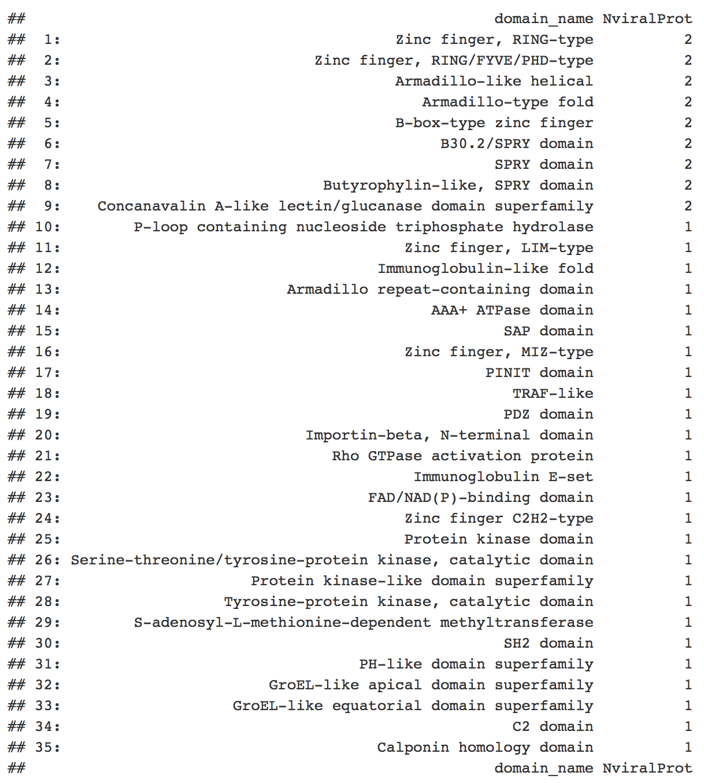
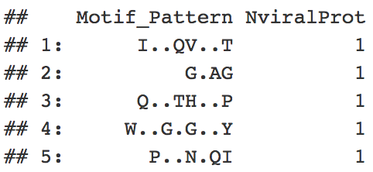
5
Potential novel motifs
Notes:
Squares are motifs

Slide 35
Thank you for attention
questions?

